Slide 1

Introduction to Computer Graphics

Slide 2
Prerequisites
You will be writing programs
data structures, pointers
An ability to learn a programming library on your own
OpenGL
Comfortable with matrix algebra and calculus
Basic linear algebra used

Slide 3
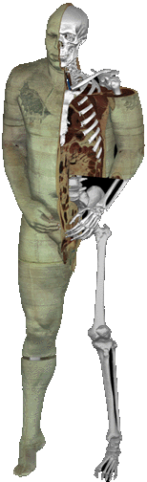
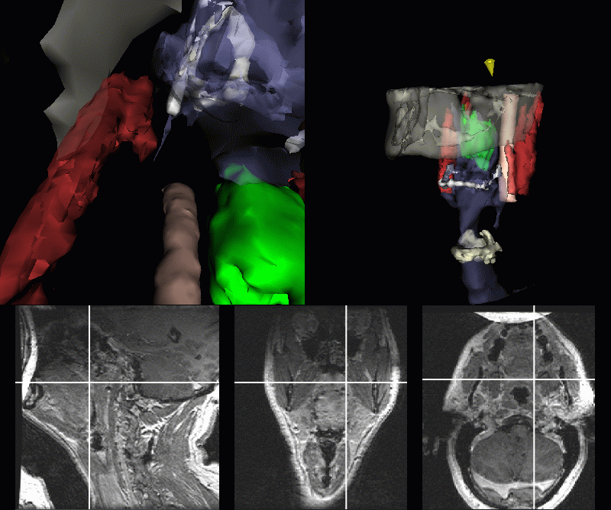
Graphics Applications
Medical Visualization

Slide 4

Graphics Applications
Entertainment: Cinema

Slide 5
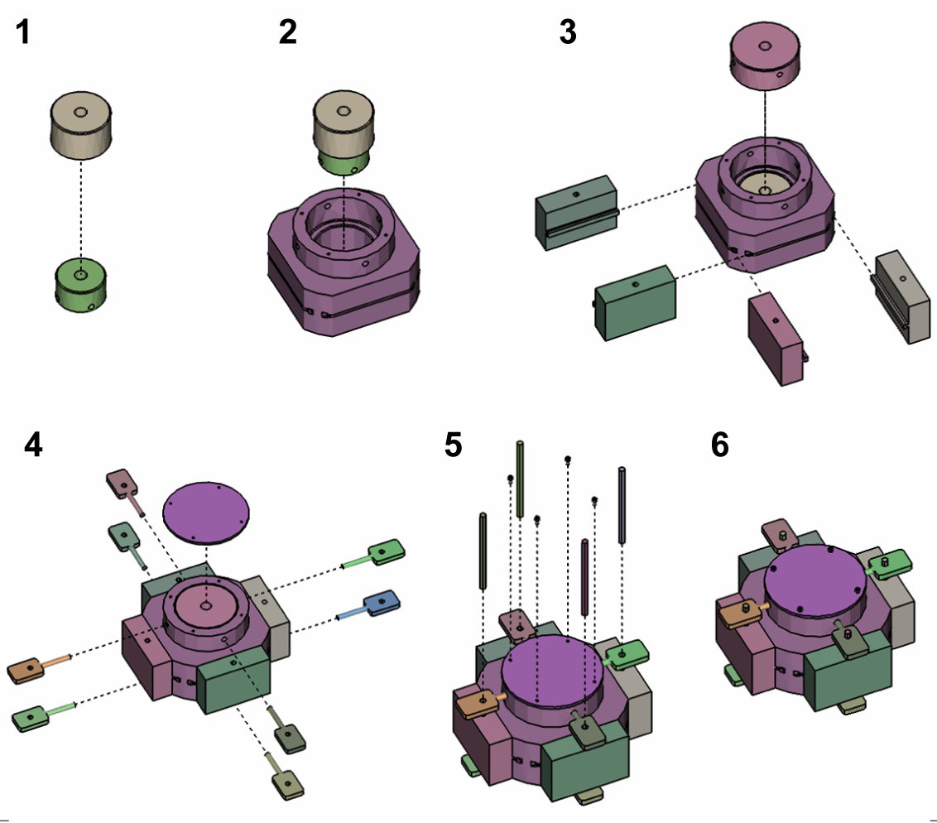
Graphics Applications
Training

Slide 6
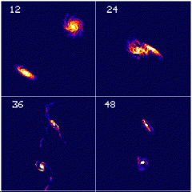
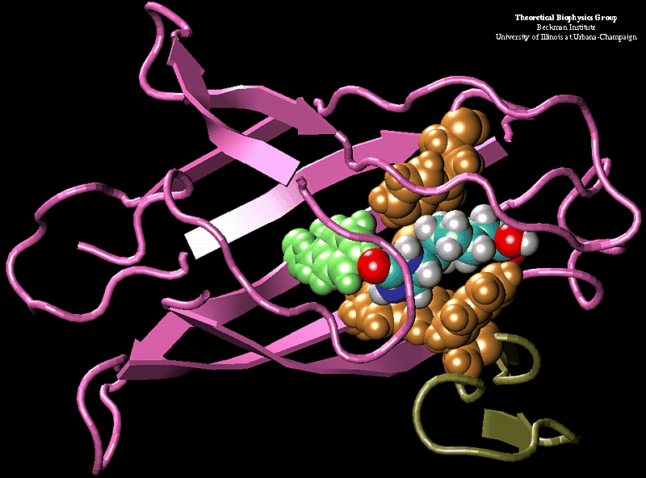
Graphics Applications
Scientific Visualization

Slide 7
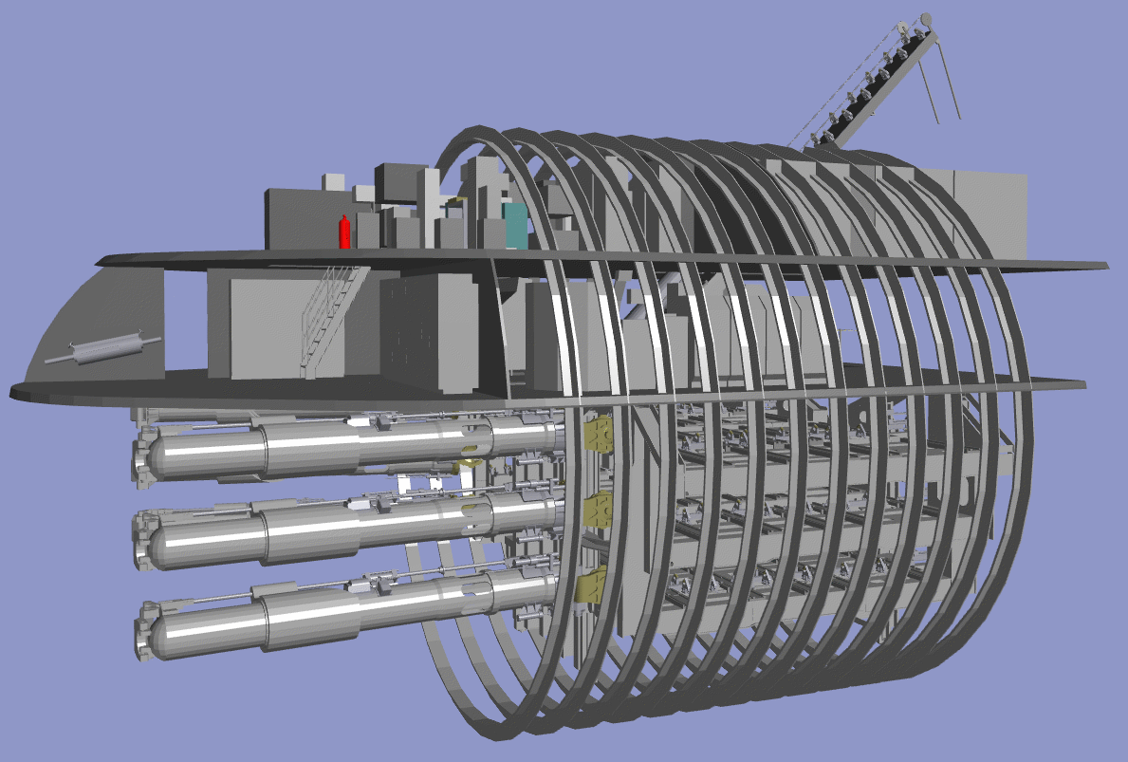
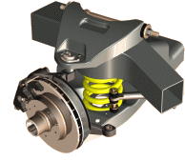
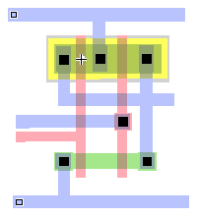
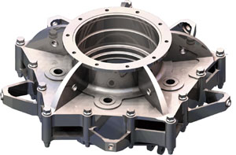
Graphics Applications
Computer Aided Design (CAD)

Slide 8
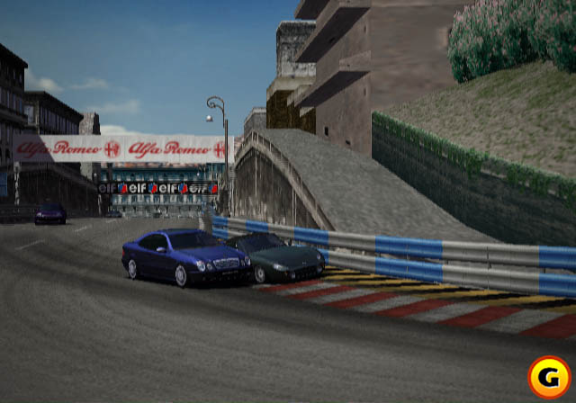
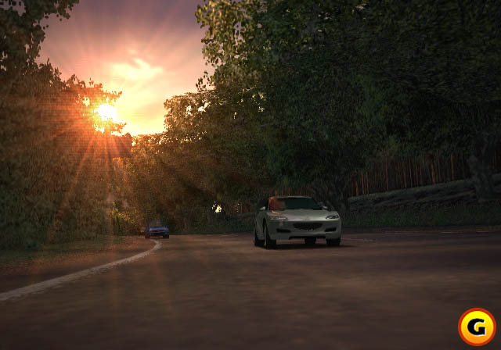
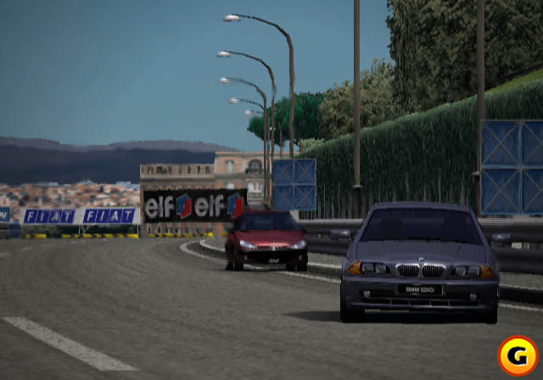
Graphics Applications
Entertainment: Games
GT Racer 3
Polyphony Digital: Gran Turismo 3, A Spec

Slide 9
What is Computer Graphics ?
The term of Computer Graphics includes almost everything on computers that is not text or sound.
It is creation, storage and manipulation of images and models using Algorithms and data structures.
It is art of drawing pictures on computer using programming. In other words, we can say that computer graphics is a rendering tool for the generation and manipulation of images.

Slide 10
Computer Graphics Made Up of 4 Components
1- Image:
Image is a combination of pixels, visual representation of something.
2- Model:
(shape) creating and representing the geometry of objects in the 3D world.
3- Rendering:
(light, perspective) generating 2D images of the objects
4- Animation:
(movement) describing how objects change in time
Notes:
the geometry : هندسي
visual representation :التمثيل المرئي
Renderingاستدعاء:/تمثيل

Slide 11
Why Study Computer Graphics?
Graphics is cool
I like to see what I’m doing
I like to show people what I’m doing
Graphics is interesting
Involves simulation, AI, algorithms, architecture…
Graphics is fun
Notes:
A game is much more than graphics. It depends what you want to do, do you want to make a game or do you want to learn what needs to be done to make a full-fledged game engine up to the point of making a usable game from it ?
Unity will enable you to make a game fast.
OpenGL will enable you to write a renderer that could be used in an engine that could then be used to make a game.
*********************************************************************
It depends on what you actually want to do. Unity is a game engine, so it's easier to make games with unity. To use opengl and c++, you have to first make your own game engine for your game. This is a tedious task and requires a high level of experience. It is easier to make games with unity. However, using opengl will expose you to computer graphics in general. This will aid your understanding of how things work. But, is this really what you want?
If you want to make games, use unity. It's easier.
If you are interested in computer graphics and prefer to implement things by yourself, use opengl. Remember, it's time consuming.

Slide 12
Introduction to OpenGL

Slide 13
OpenGL: Setup in Windows
You can download this library from https://drive.google.com/file/d/0B7Ps5OIRby61QWJyYUt1MndVMjg/view
Assume that Visual Studio was installed.
Open Visual Studio.
Create Empty Project.
Right click on project name select Properties.
Then:

Slide 14
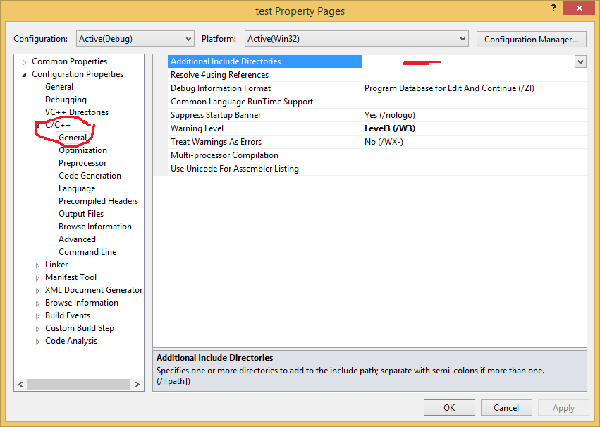
OpenGL: Setup in Windows

Slide 15
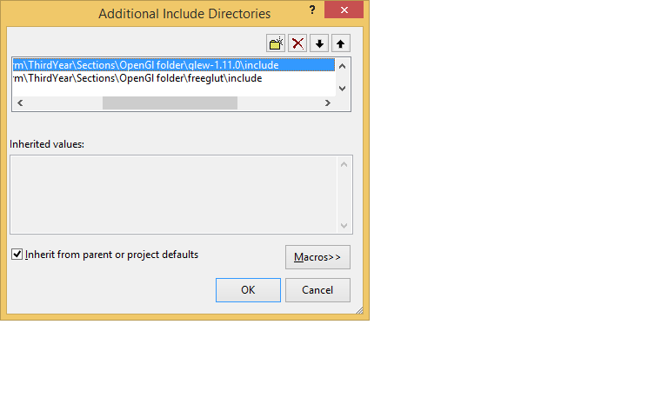
OpenGL: Setup in Windows

Slide 16
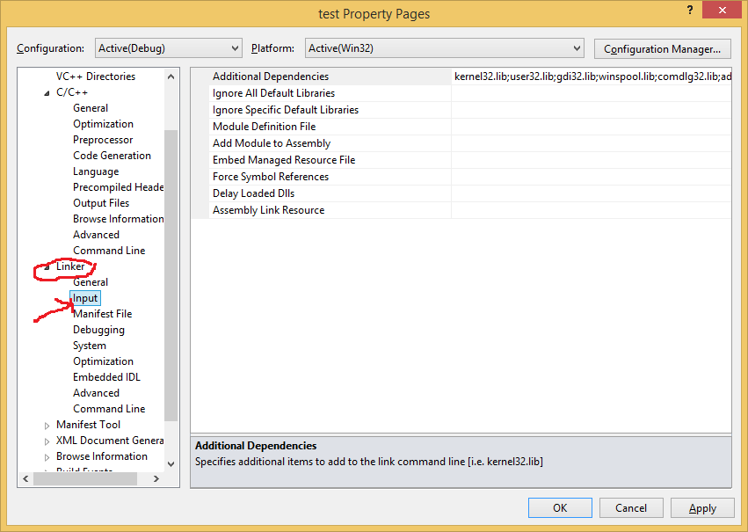
OpenGL: Setup in Windows

Slide 17
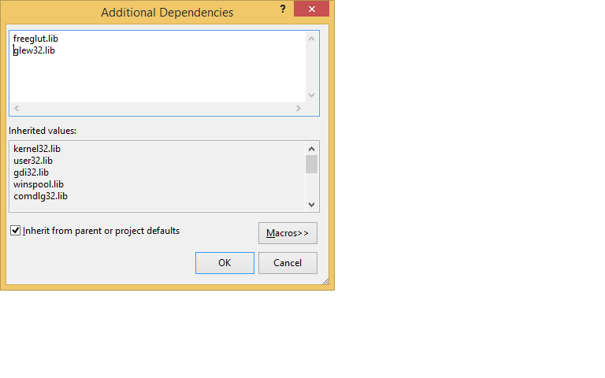
OpenGL: Setup in Windows

Slide 18
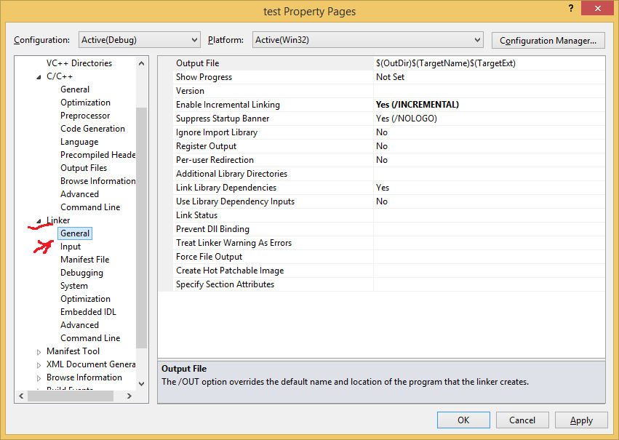
OpenGL: Setup in Windows

Slide 19

OpenGL: Setup in Windows

Slide 20
OpenGL: Setup in Windows
The copy freeglut.dll and glew32.dll files to the location of your project ( by right click on project name then select open folder in windows explorer

Slide 21
What is Opengl
OpenGL is a software interface to graphics hardware

Slide 22
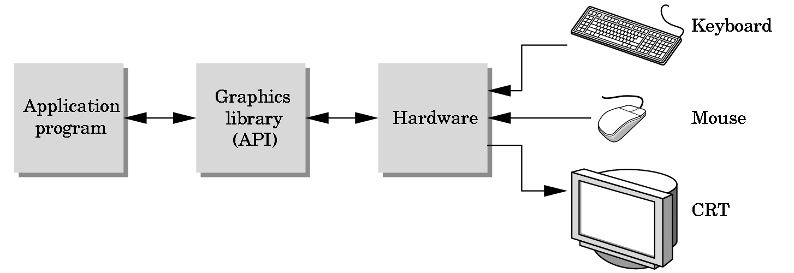
The Programmer’s Interface
Programmer sees the graphics system through a software interface: the Application Programmer Interface (API)

Slide 23
API Contents
Functions that specify what we need to form an image
Objects
Viewer
Light Source(s)
Materials
Other information
Input from devices such as mouse and keyboard
Capabilities of system

Slide 24
History of OpenGL
Silicon Graphics (SGI) revolutionized the graphics workstation by implementing the pipeline in hardware (1982)
To access the system, application programmers used a library called GL
With GL, it was relatively simple to program three dimensional interactive applications

Slide 25
OpenGL: What is It?
The success of GL lead to OpenGL (1992), a platform-independent API that was
Easy to use
Close enough to the hardware to get excellent performance
Focus on rendering
Omitted windowing and input to avoid window system dependencies

Slide 26
OpenGL Evolution
Controlled by an Architectural Review Board (ARB)
Members include SGI, Microsoft, Nvidia, HP, 3DLabs, IBM,…….
Relatively stable (present version 2.0)
Evolution reflects new hardware capabilities
3D texture mapping and texture objects
Vertex programs
Allows for platform specific features through extensions

Slide 27
Why Opengl
Open source graphics library
http://www.opengl.org
Device-independent graphics programming
Windows based programming
Event- driven programming,
event queue, Callback functions, Event event loop.
Glut library support event

Slide 28
OpenGL Libraries
GL (Graphics Library): Library of 2-D, 3-D drawing primitives and operations
API for 3-D hardware acceleration
GLU (GL Utilities): Miscellaneous functions dealing with camera set-up and higher-level shape descriptions
GLUT (GL Utility Toolkit): Window-system independent toolkit with numerous utility functions, mostly dealing with user interface

Slide 29
Software Organization
application program
OpenGL Motif
widget or similar
GLUT
GLX, AGL or WGL
GLU
X, Win32, Mac O/S
GL
software and/or hardware

Slide 30
Lack of Object Orientation
OpenGL is not object oriented so that there are multiple functions for a given logical function
glVertex3f
glVertex2i
glVertex3dv
Underlying storage mode is the same
Easy to create overloaded functions in C++ but issue is efficiency

Slide 31
OpenGL function format
function name
dimensions
glVertex3f(x,y,z)
x,y,z are floats
belongs to GL library
glVertex3fv(p)
p is a pointer to an array

Slide 32
Program Structure
include files
Main function
Initialize glut and display
Create window
Register Callbacks functions
Additional initialization for creating coordinate system
Main Loop (event loop)

Slide 33
Program Structure
Registered functions
Display function(rendering func), Mouse, Keyboard, Motion, Redisplay ……functions

Slide 34



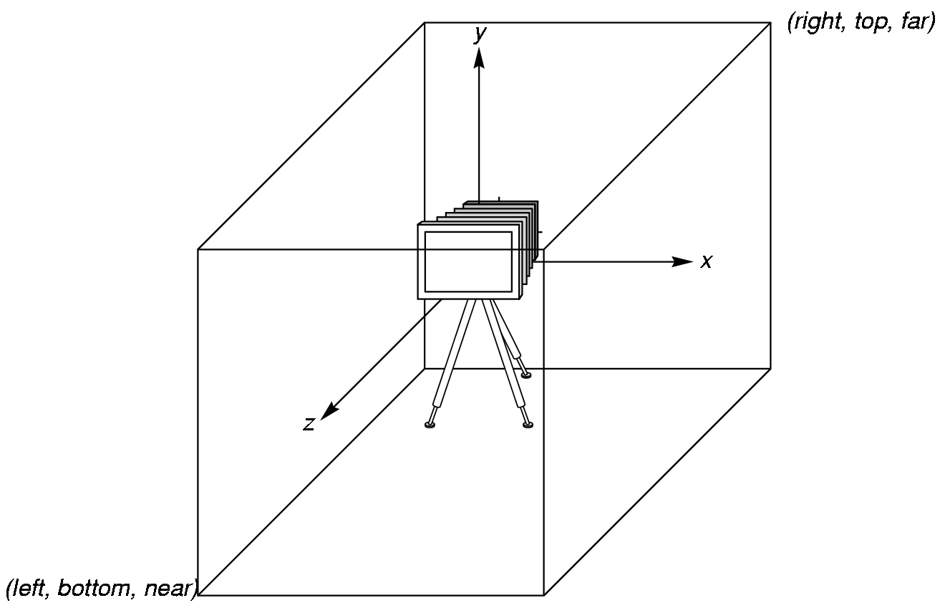
Coordinate Systems &OpenGL Camera
Right-handed system
From point of view of camera looking out into scene:
OpenGL places a camera at the origin in object space pointing in the negative z direction
Positive rotations are counterclockwise around axis of rotation

Slide 35
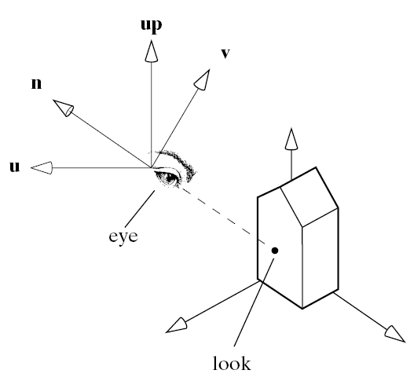
OpenGL Camera
The units in glVertex are determined by the application and are called object or problem coordinates
The viewing specifications are also in object coordinates and it is the size of the viewing volume that determines what will appear in the image
Internally, OpenGL will convert to camera (eye) coordinates and later to screen coordinates

Slide 36
Transformations in OpenGl
Modeling transformation
Refer to the transformation of models (i.e., the scenes, or objects)
Viewing transformation
Refer to the transformation on the camera
Projection transformation
Refer to the transformation from scene to image

Slide 37
simple.c revisited
includes gl.h
#include <GL/glut.h>
int main(int argc, char** argv)
{
glutInit(&argc,argv);
glutInitDisplayMode(GLUT_SINGLE|GLUT_RGB);
glutInitWindowSize(500,500);
glutInitWindowPosition(0,0);
glutCreateWindow("simple");
glutDisplayFunc(mydisplay);
init();
glutMainLoop();
}
define window properties
display callback
set OpenGL state
enter event loop

Slide 38
GLUT functions
glutInit allows application to get command line arguments and initializes system
gluInitDisplayMode requests properties for the window (the rendering context)
RGB color
Single buffering
Properties logically ORed together
glutWindowSize in pixels
glutWindowPosition from top-left corner of display
glutCreateWindow create window with title “simple”
glutDisplayFunc display callback
glutMainLoop enter infinite event loop

Slide 39
Sets the logical coordinate system
black clear color
void setTransformations()
{
glClearColor (0.0, 0.0, 0.0, 1.0);
glColor3f(1.0, 1.0, 1.0);
glMatrixMode (GL_PROJECTION);
glLoadIdentity ();
glOrtho(-1.0, 1.0, -1.0, 1.0, -1.0, 1.0);
}
opaque window
fill/draw with white
viewing volume

Slide 40
Display callback function
void ondisplay()
{
glClear(GL_COLOR_BUFFER_BIT);
glBegin(GL_POLYGON);
glVertex2f(-0.5, -0.5);
glVertex2f(-0.5, 0.5);
glVertex2f(0.5, 0.5);
glVertex2f(0.5, -0.5);
glEnd();
glFlush();
}

Slide 41

Input and Interaction
Multiple input devices, each of which can send a trigger to the operating system at an arbitrary time by a user
Button on mouse
Pressing or releasing a key
Each trigger generates an event whose measure is put in an event queue which can be examined by the user program

Slide 42
Callbacks
Programming interface for event-driven input
Define a callback function for each type of event the graphics system recognizes
This user-supplied function is executed when the event occurs
GLUT example: glutMouseFunc(mymouse)
mouse callback function

Slide 43
GLUT event loop
Last line in main.c for a program using GLUT is the infinite event loop
glutMainLoop();
In each pass through the event loop, GLUT
looks at the events in the queue
for each event in the queue, GLUT executes the appropriate callback function if one is defined
if no callback is defined for the event, the event is ignored
In main.c
glutDisplayFunc(mydisplay) identifies the function to be executed
Every GLUT program must have a display callback

Slide 44
Assignment policy
Using OpenGl primitives , Draw your specific object .

